Slide 1
Week 5: Spatial Filters for Image Enhancement
Hazal Mogultay and Fatoş Tunay Yarman Vural

Slide 2
Image Enhancement in Space Domain
Point operations
Gray scale transform
Bit plane slicing
Histogram equalization
Histogram specification
Spatial Filtering: Convolution
Smoothing filters
Sharpening filters

Slide 3
What is image filtering?
f(x,y)
g(x,y)
Filter
filtering
Notes:
3

Slide 4

Human brain hierarchically unifies the signals to create meaning
Natural Vision
Computer Vision
$$H: f(x,y) L$$
Notes:
İnferior temporal gyrus

Slide 5
How do we unify signals to extract meanings, algorithmically?
FİLTERİNG

Slide 6
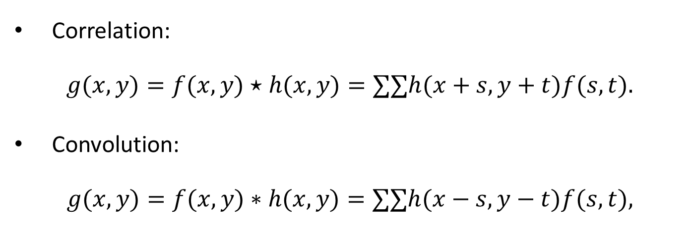
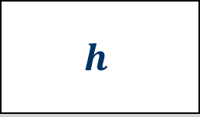


Linear Filters:
$$h$$
$$g [x,y]$$
$$f [x,y]$$
-
-
Correlation:
$$g(x,y)=f(x,y)⋆h(x,y)=∑​∑​h(x+s,y+t)f(s,t).$$
Convolution:
$$g(x,y)=f(x,y)∗h(x,y)=∑​∑​h(x−s,y−t)f(s,t),$$

Slide 7
Filter design
h is an nxm matrix, called filter, kernel, mask, window
How to select entries?
How to select size?
-1 | 2 | -1
-1 | 2 | -1
-1 | 2 | -1

Slide 8





Select the origin for image and filter
111 | 115 | 113 | 111 | 112 | 111 | 112 | 111
135 | 138 | 137 | 139 | 145 | 146 | 149 | 147
163 | 168 | 188 | 196 | 206 | 202 | 206 | 207
180 | 184 | 206 | 219 | 202 | 200 | 195 | 193
189 | 193 | 214 | 216 | 104 | 79 | 83 | 77
191 | 201 | 217 | 220 | 103 | 59 | 60 | 68
195 | 205 | 216 | 222 | 113 | 68 | 69 | 83
199 | 203 | 223 | 228 | 108 | 68 | 71 | 77
? | ? | ? | ? | ? | ? | ? | ?
? | -5 | 9 | -9 | 21 | -12 | 10 | ?
? | -29 | 18 | 24 | 4 | -7 | 5 | ?
? | -50 | 40 | 142 | -88 | -34 | 10 | ?
? | -41 | 41 | 264 | -175 | -71 | 0 | ?
? | -24 | 37 | 349 | -224 | -120 | -10 | ?
? | -23 | 33 | 360 | -217 | -134 | -23 | ?
? | ? | ? | ? | ? | ? | ? | ?
-1 | 2 | -1
-1 | 2 | -1
-1 | 2 | -1
=
$$f(x,y)$$
$$h(x,y)$$
$$g(x,y)$$

Slide 9
2-D Convolution

Slide 10
Convolution with averaging filters
10
11
10
0
0
1
X
X
X
X
X
X
9
10
11
1
0
1
X
10
X
I
10
9
10
0
2
1
O
X
X
11
10
9
10
9
11
X
X
9
10
11
9
99
11
F
X
X
10
9
9
11
10
10
X
X
X
X
X
X
1
1
1
1/9
1
1
1
1
1
1
1/9.(10x1 + 11x1 + 10x1 + 9x1 + 10x1 + 11x1 + 10x1 + 9x1 + 10x1) =
1/9.( 90) = 10
Adapted from Octavia Camps, Penn State

Slide 11
Convolution with averaging filters
10
11
10
0
0
1
X
X
X
X
X
X
9
10
11
1
0
1
X
X
I
10
9
10
0
2
1
O
X
X
11
10
9
10
9
11
X
X
9
10
11
9
99
11
F
X
20
X
10
9
9
11
10
10
X
X
X
X
X
X
1
1
1
1/9
1
1
1
1
1
1
1/9.(10x1 + 9x1 + 11x1 + 9x1 + 99x1 + 11x1 + 11x1 + 10x1 + 10x1) =
1/9.( 180) = 20
Adapted from Octavia Camps, Penn State

Slide 12
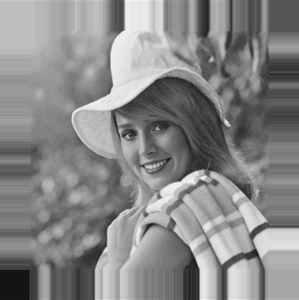
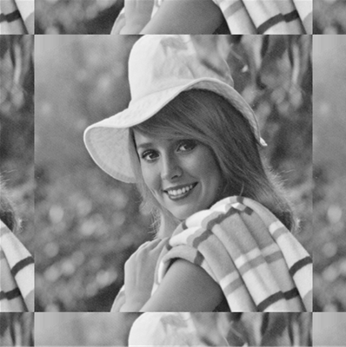
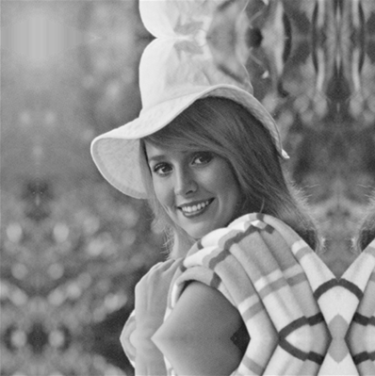
Practical implementation of Convolution
Be careful about indices, image borders and padding during implementation.
zero
fixed/clamp
periodic/wrap
reflected/mirror
Border padding examples.
Adapted from CSE 455, U of Washington

Slide 13
What is convolution realy?

Slide 14
Example: One-dimensional Convolution What is the amount of filter function in a particular time instance of the input function?
Convolution 2

Slide 15
Example: One-dimensional convolution The amount of filter function in the input function

Slide 16
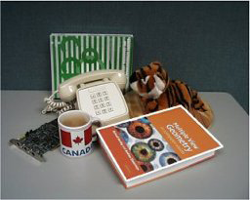

Convolution operation measures the similarity between the image and mask
mask
=

Slide 17
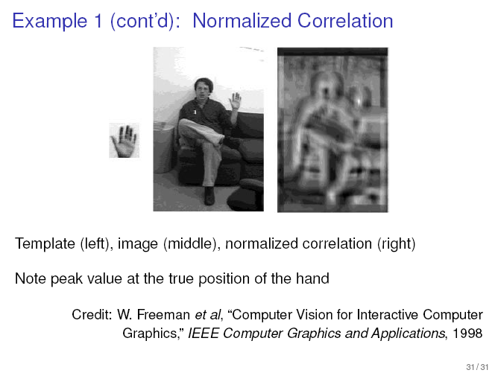
Application : TV Remote Control by Normalized correlation

Slide 18
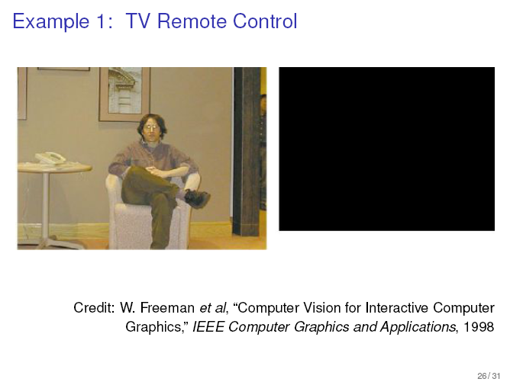
Application: TV Remote Control

Slide 19
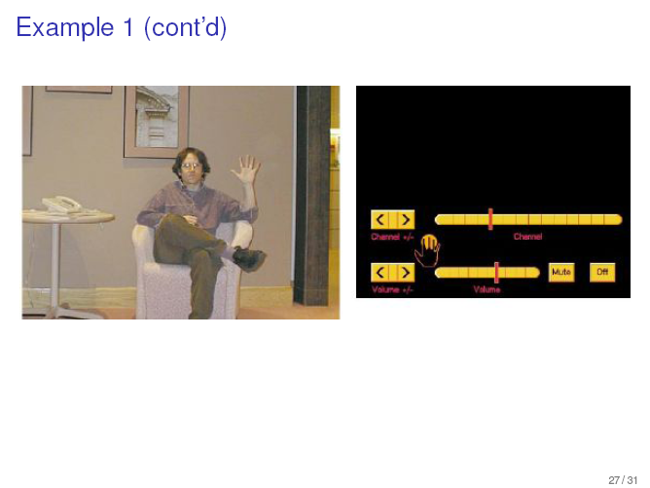
Application : TV Remote Control (cont’d)

Slide 20
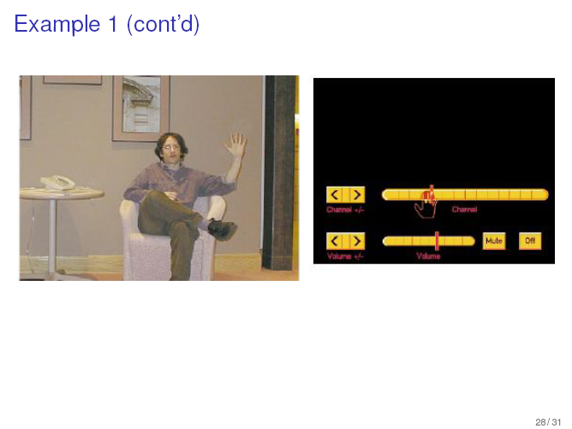
Application : TV Remote Control (cont’d)

Slide 21
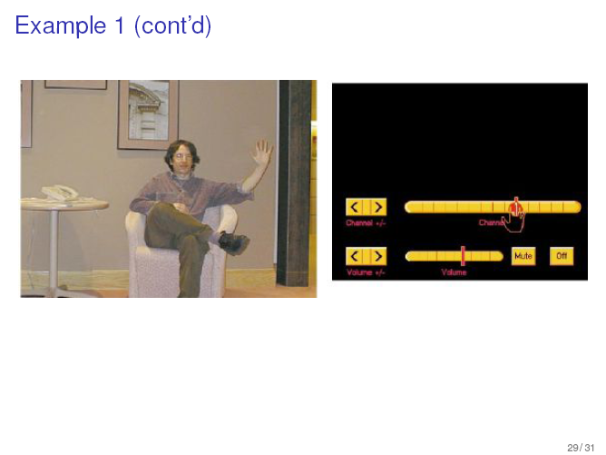
Application : TV Remote Control (cont’d)

Slide 22
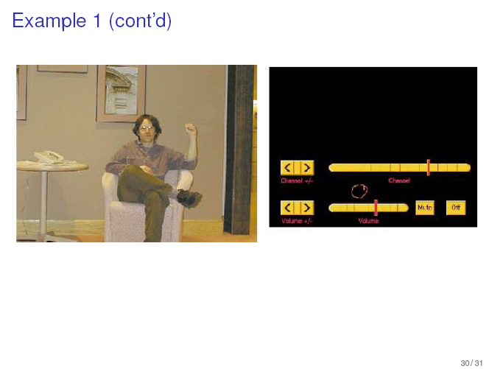
Application : TV Remote Control (cont’d)

Slide 23
Two major types of filters
1. Smoothing Filters
Averaging filters
Gaussian filters
Median Filters
2. Sharpening Filters
Roberts
Prewitt
Sobel
Etc.

Slide 24
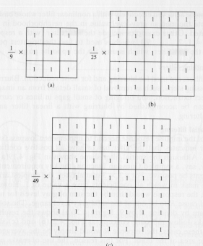
1.1. Smoothing Filters: Averaging
Idea: Replace each pixel by the average of its neighbors.
Useful for reducing noise and unimportant details.
The size of the mask controls the amount of smoothing.

Slide 25
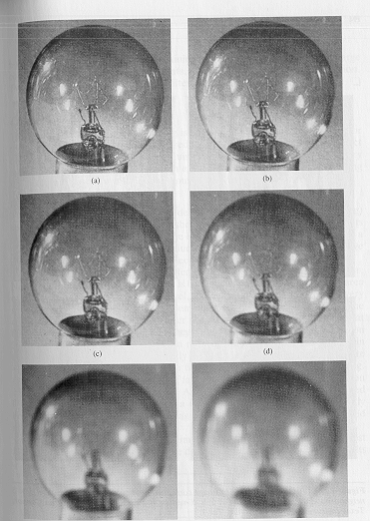
Output of Averaging filters: Removes noise while blurs.
original
3x3
5x5
7x7
15x15
25x25

Slide 26
Averaging with a filter size 3x3, 5x5, 9x9, 15x15, 35x35

Slide 27
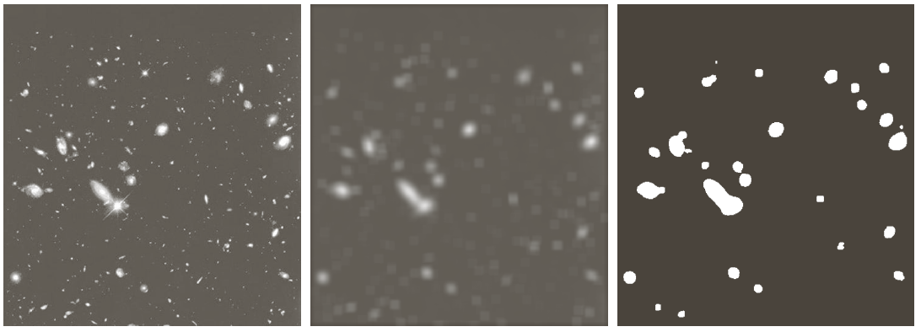
Image enhancement with averaging

Slide 28
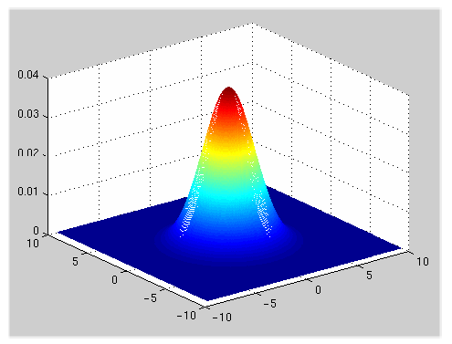

1.2.Gaussian Filters for Smoothing
A weighted average that weighs pixels at its center much more strongly than its boundaries.
2D Gaussian filter.
σ is standard deviation
Adapted from Martial Hebert, CMU

Slide 29
Need to sample and quantize the Gaussian function
sample and quantize

Slide 30
1.2. Sampling and quantization of the filter
Depends on
Allowable mask size
Standart deviation σ , which determines the degree of smoothing
σ=3

Slide 31
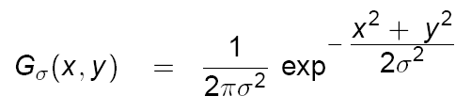
1.2. Gaussian Filters for Smoothing
Idea: replace each pixel by a weighted average of its neighbors
Mask weights are computed by sampling a Gaussian function
Note: weight values decrease with distance from mask center!

Slide 32
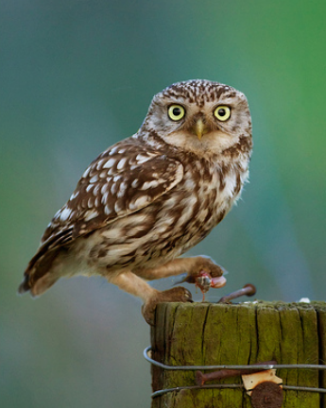
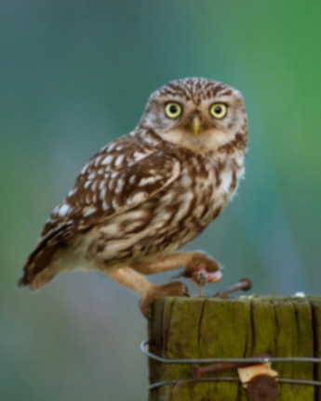



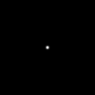




Gaussian Smoothing - Example
= 1 pixel
= 5 pixels
= 10 pixels
= 30 pixels

Slide 33
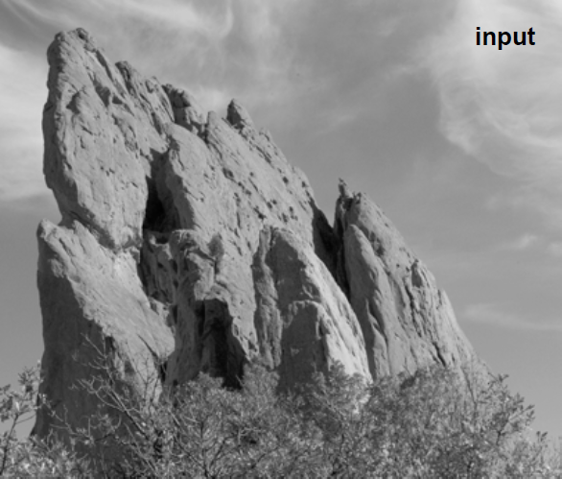
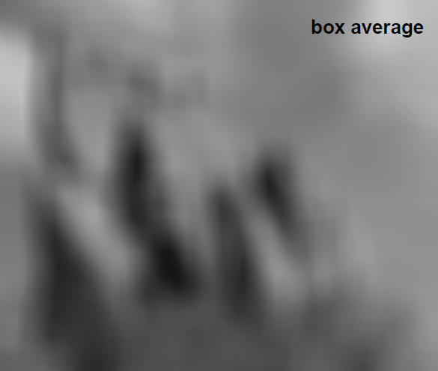
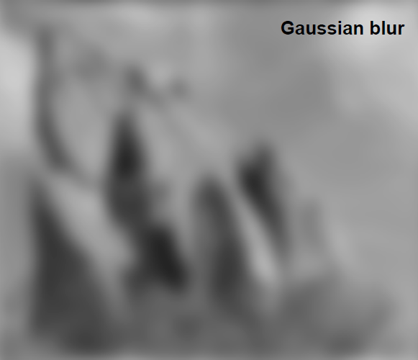
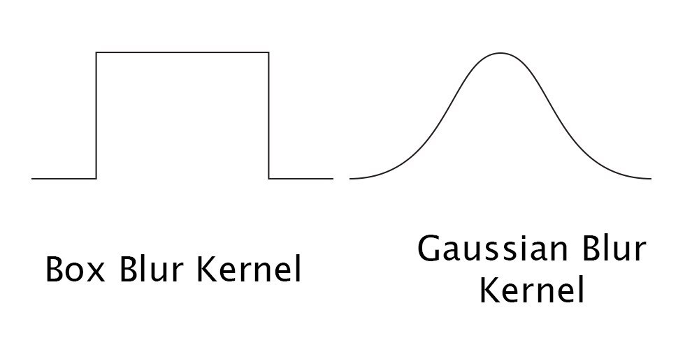
Averaging vs Gaussian Smoothing

Slide 34
1.3 Nonlinear Smoothing Filters: Median Filters
Find a median value of a given neighborhood.
Assign a pixel the median value of its neighbors
0 | 2 | 1
2 | 1 | 2
3 | 3 | 2
0 | 2 | 1
2 | 2 | 2
3 | 3 | 2
0 1 1 2 2 2 2 3 3

Slide 35
Median Filtering

Slide 36
Median Filtering removes sand like noise

Slide 37
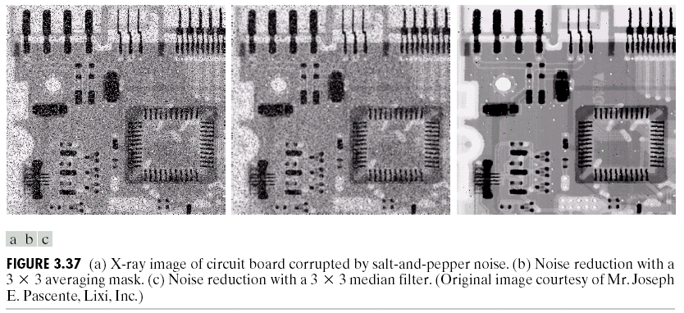
Median filter is a nonlinear filter
Removes sand like noise

Slide 38
Median filtering breaks the straight lines
Square filter:
0 0 0 5 5 5 5 5 5
5 | 5 | 5 | 5 | 5
5 | 5 | 5 | 5 | 5
0 | 0 | 0 | 0 | 0
5 | 5 | 5 | 5 | 5
5 | 5 | 5 | 5 | 5

Slide 39
Median filtering breaks the straight lines
Square filter:
0 0 0 5 5 5 5 5 5
Cross filter
0 0 0 0 0 5 5 5 5
5 | 5 | 5 | 5 | 5
5 | 5 | 5 | 5 | 5
0 | 0 | 0 | 0 | 0
5 | 5 | 5 | 5 | 5
5 | 5 | 5 | 5 | 5

Slide 40
2. Sharpening Filters: Edge detectors
Edges are the pixels where the brightness changes abruptly in some of its neighbors

Slide 41
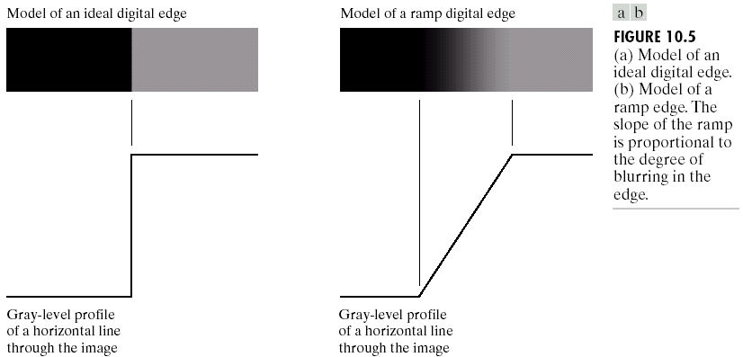
EDGE PROFILES

Slide 42
Mathematical Representation of Edge
Edges are defined by
Gradient ,
Laplacian
of a two dimensional image function, f(x,y).

Slide 43
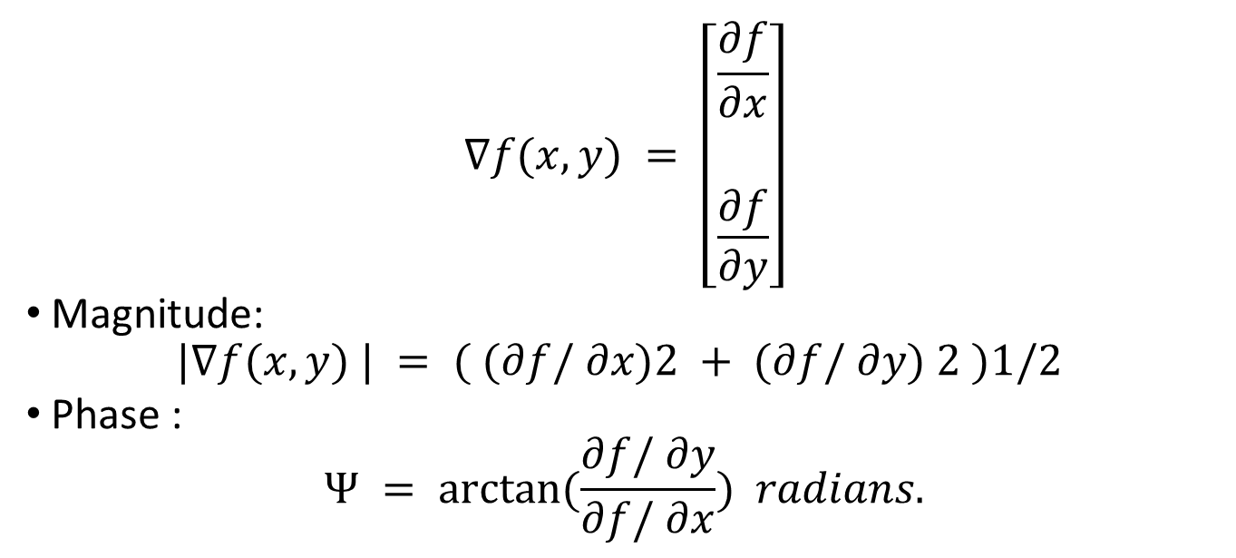
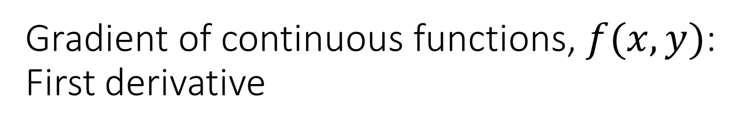
Gradient of continuous functions, $f(x,y)$: First derivative
$$∇f(x,y) = \left[\begin{aligned}\frac{∂f}{∂x} \\ \frac{\begin{aligned} \\ ∂f\end{aligned}}{∂y}\end{aligned}\right]$$
Magnitude:
$$|∇f(x,y) | = ( (∂f/ ∂x)2 + (∂f/ ∂y) 2 )1/2$$
Phase :
$$Ψ = arctan⁡(\frac{∂f/ ∂y}{∂f/ ∂x}) radians.$$

Slide 44
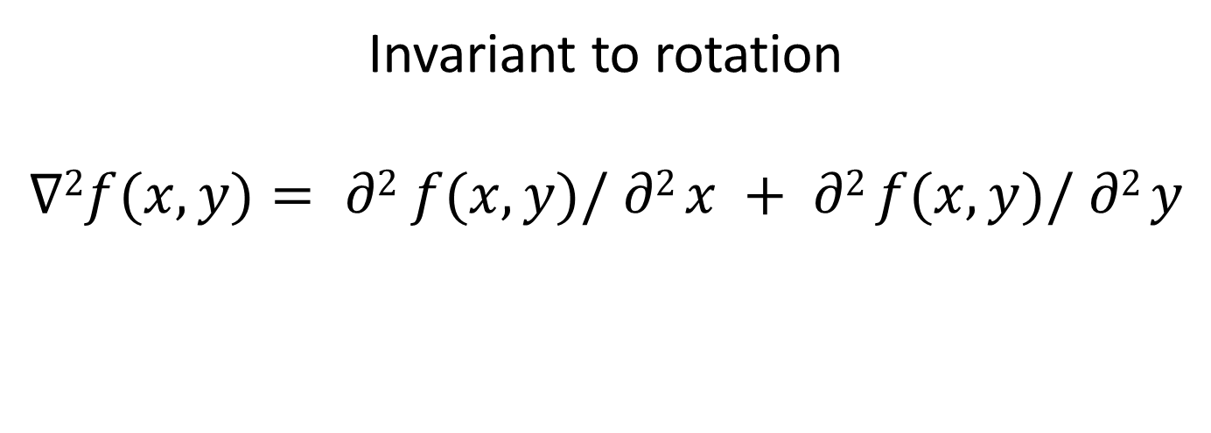
Laplacian of a continuous function, f(x,y): Second derivative
Invariant to rotation
$$∇2f(x,y)= ∂2 f(x,y)/ ∂2 x + ∂2 f(x,y)/ ∂2 y$$

Slide 45
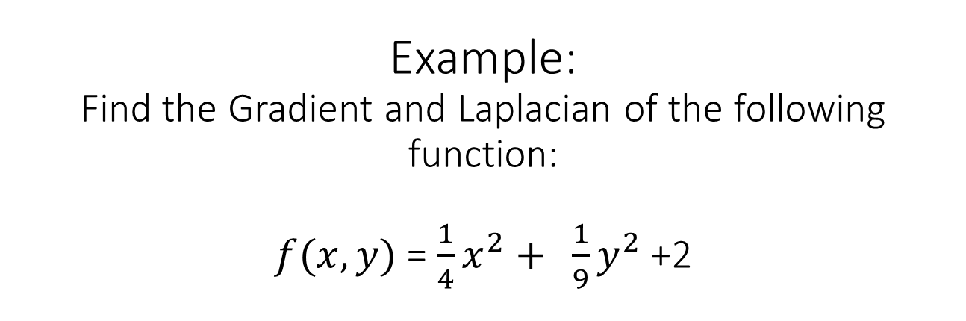
Example: Find the Gradient and Laplacian of the following function: $f(x,y)$ = $\frac{1}{4}x^{2}{ + \frac{1}{9}y}^{2}$ +2

Slide 46
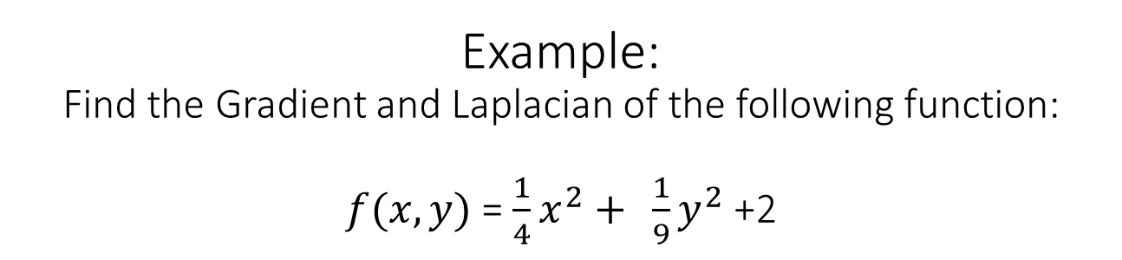

Example: Find the Gradient and Laplacian of the following function: $f(x,y)$ = $\frac{1}{4}x^{2}{ + \frac{1}{9}y}^{2}$ +2
Gradient:
$∇f(x,y) = [∂f/ ∂x ∂f/ ∂y]T$⁼
Laplacian
$$∇2f(x,y)= ∂2 f(x,y)/ ∂2 x + ∂2 f(x,y)/ ∂2 y$$

Slide 47
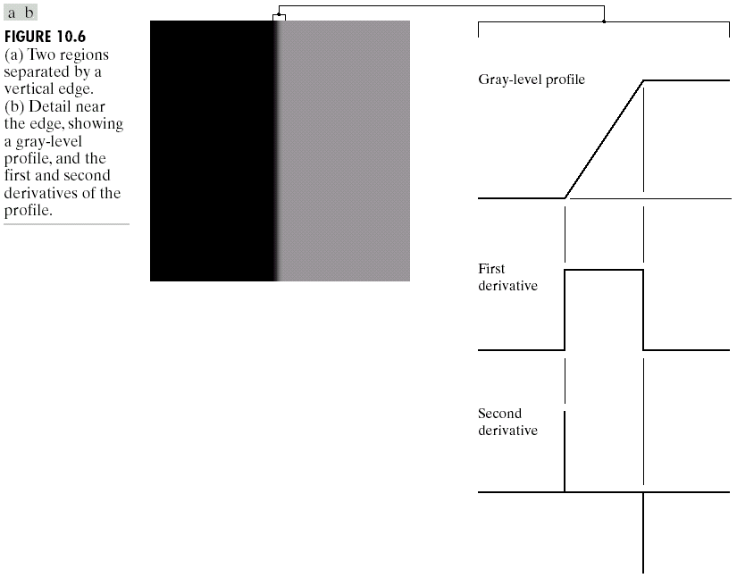
Edge, Gradient, Laplacian

Slide 48
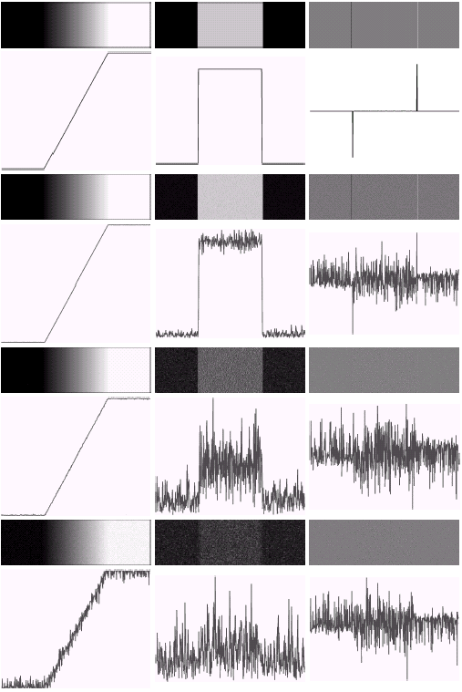

Gradient and Laplacian of , Smooth and Noisy Edges

Slide 49
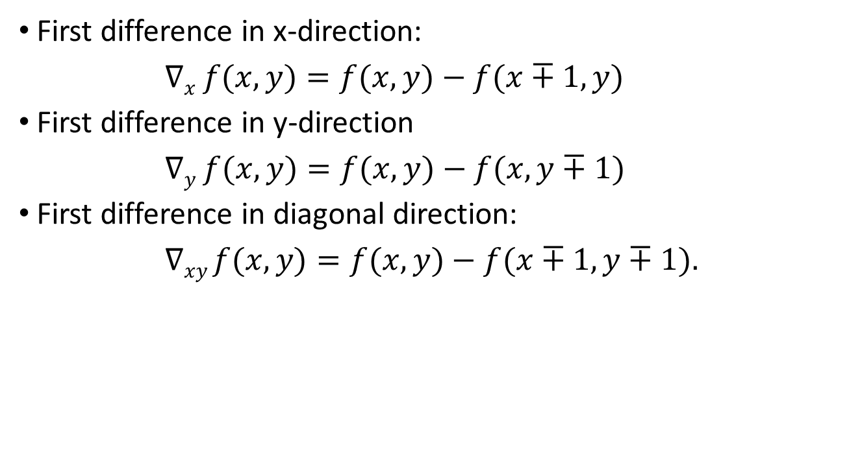
First Difference Operation Approximates Gradient for Discrete Functions
First difference in x-direction:
$∇x​ f(x,y)=f(x,y)−f(x∓1,y)$
First difference in y-direction
$∇y​ f(x,y)=f(x,y)−f(x,y∓1)$
First difference in diagonal direction:
$∇​xy f(x,y)=f(x,y)−f(x∓1,y∓1).$

Slide 51
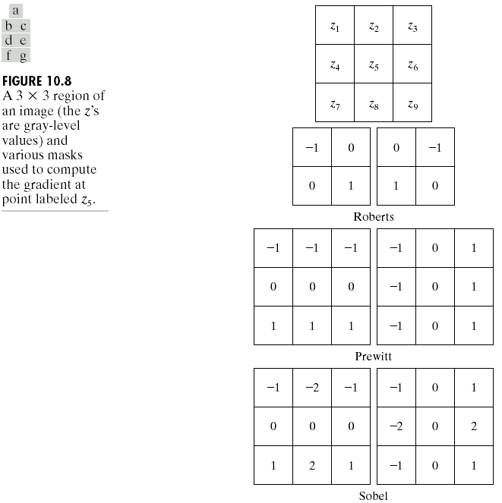


How to use convolution to approximate the first derivative
$g\left(x,y\right)=f\left(x,y\right)∗h\left(x,y\right)$ =
$∇x​ f(x,y) or ∇y​ f(x,y) or ∇​xy f(x,y)$
$$h\left(x,y\right)=$$

Slide 52
2x2 Gradient Edge Masks: Approximation in discrete grid Roberts mask for detecting diagonal edges

Slide 53
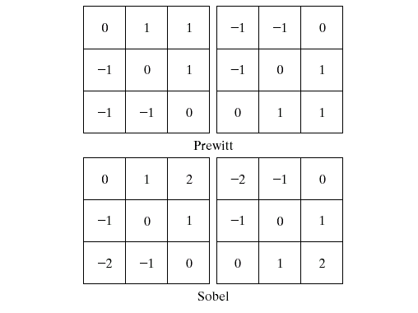
3x3 Gradient Edge Masks

Slide 54
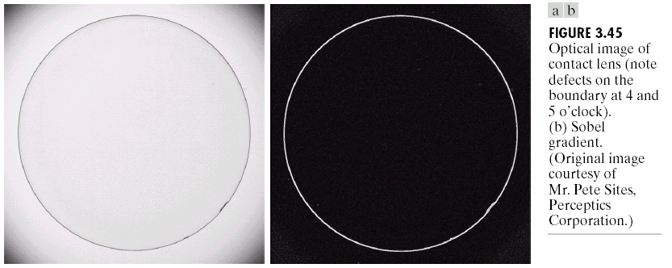
Sobel Edge Detector as a Discrete Gradient Operator

Slide 55
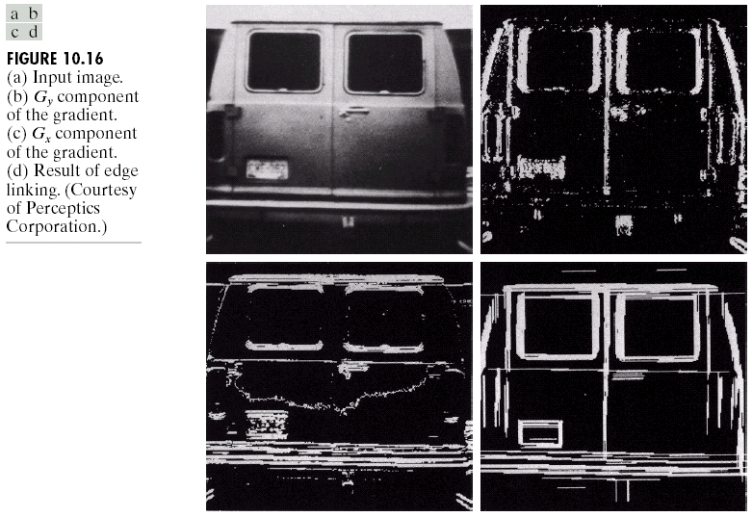
Edge Detection by Vertical and Horizontal Gradient Operators

Slide 56
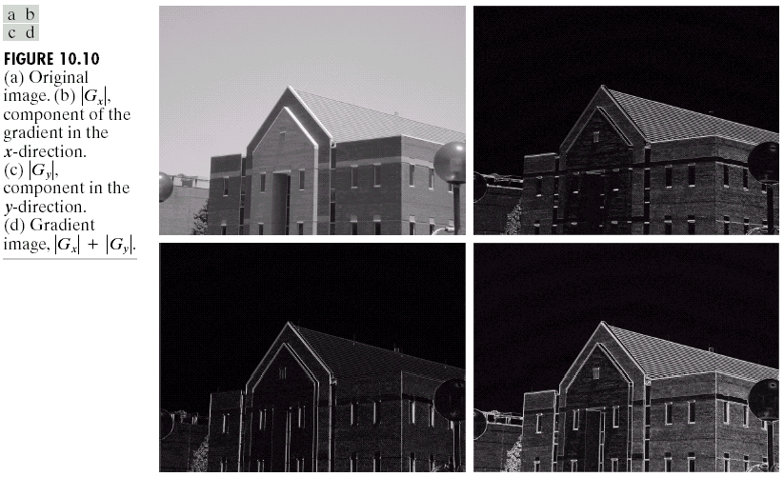
Diagonal Edge Detection by Vertical and Horizontal Gradient operators

Slide 57
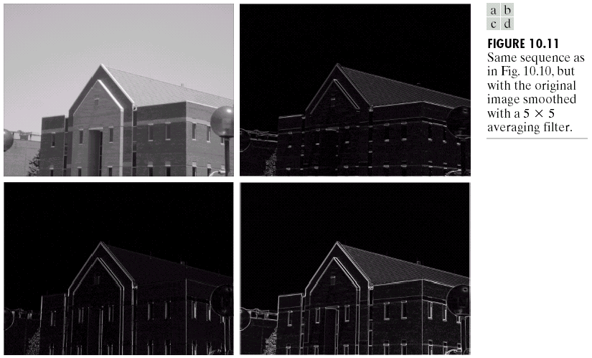
Edge detection after Smoothing with Vertical and Horizontal Gradient filters

Slide 58
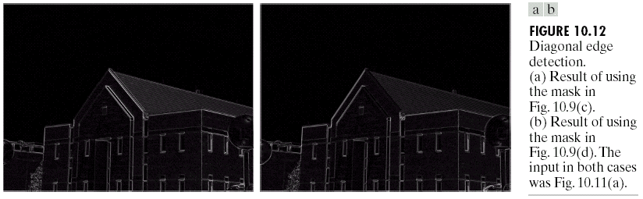
Edge Detection after Smoothing with Diagonal Gradient filters

Slide 59
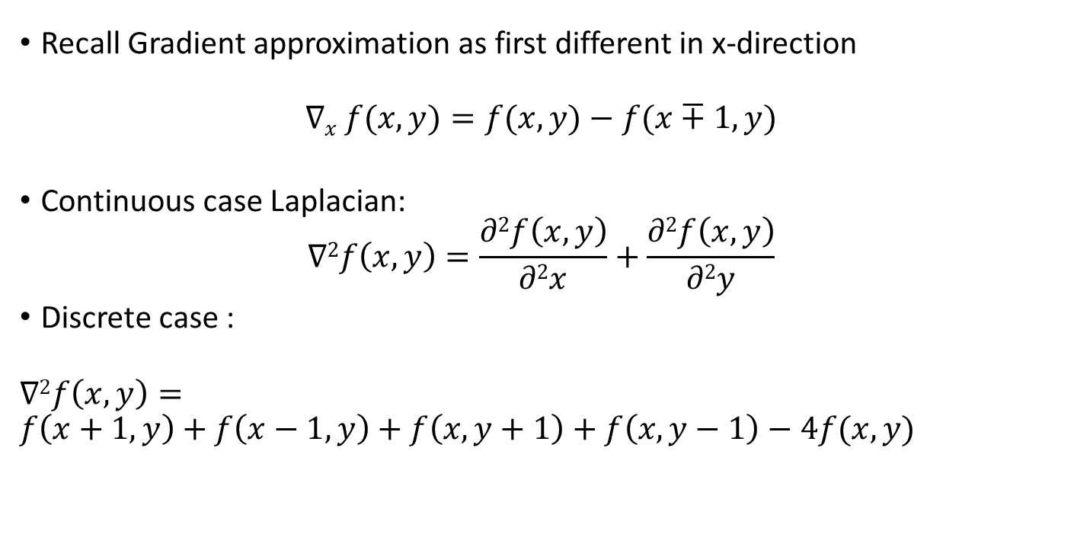
LAPLACIAN MASKS: Approximation of second derivative filters
Recall Gradient approximation as first different in x-direction
$$∇x​ f(x,y)=f(x,y)−f(x∓1,y)$$
Continuous case Laplacian:
$$∇2f\left(x,y\right)=\frac{∂2f\left(x,y\right)}{∂2x}+\frac{∂2f\left(x,y\right)}{∂2y}$$
Discrete case :
$$∇2f\left(x,y\right)=$$
$$f\left(x+1,y\right)+f\left(x−1,y\right)+f\left(x,y+1\right)+f\left(x,y−1\right)−4f(x,y)$$

Slide 60
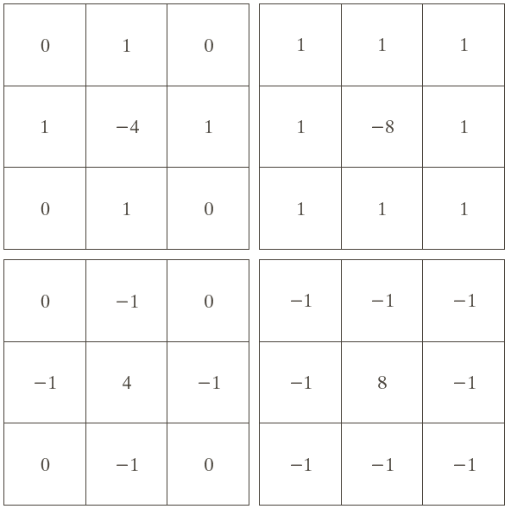
Sharpening Filters: Laplace Operator

Slide 61

Laplacian of Gaussian Filters: Second derivative of Gaussian Function
Recall Gaussian Function
Laplacian of Gaussian
$$Δ2 G(x,y) = ∂2 G(x,y)/ ∂2 x + ∂2 G(x,y)/ ∂2 y$$

Slide 62
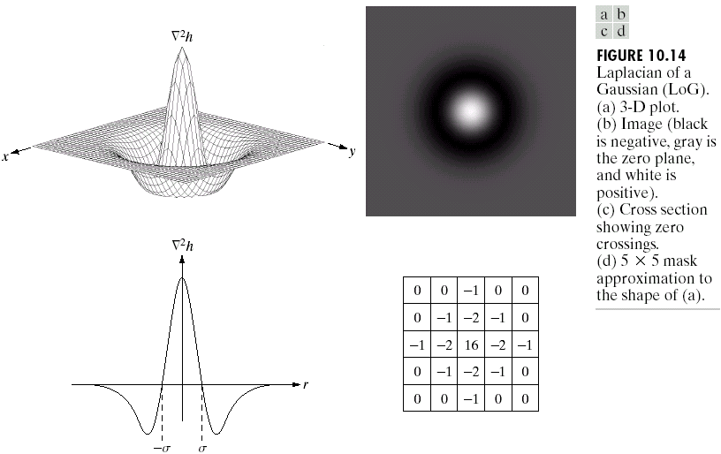
LAPLACIAN of GAUSSIAN EDGE MASKS Second derivative of the Gaussian function

Slide 63
LoG for 9x9 discrete grid

Slide 64
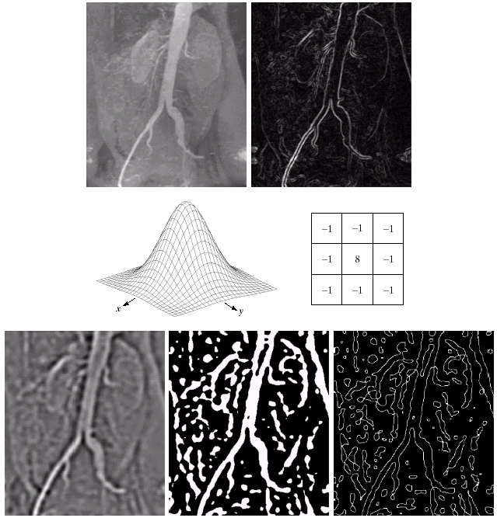
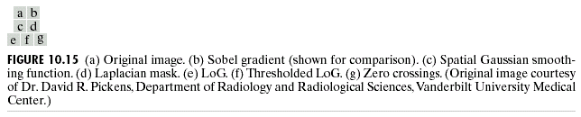
Edge Detection in Radiological Images
Sobel
LoG

Slide 65
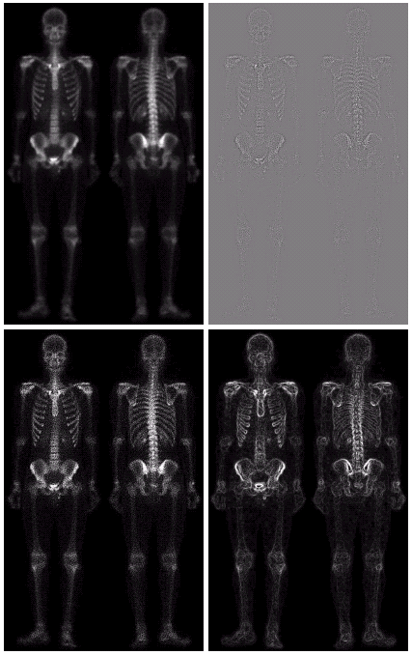

Image Enhancement with Laplacian and Sobel
Laplacian
Original+ Laplacian
Sobel

Slide 66


Image Enhancement by Combination of Smoothing, Laplacian, Sobel and PLT
A=(Original+Laplacian).( Sobel+smoothing)
Sobel+smoothing
by 5x5 averaging mask
O+A
PLT(O+A)

Slide 67

Image Enhancement with Composite Laplacian Masks

Slide 68

Image Enhancement with Laplacian

Slide 69

Laplacian Operator
Original+
c.Laplacian

Slide 70


Slide 71

Quiz: 4 Find the equalized histogram and the corresponding image of the following 3 bits/pixel image:
f(x,y) = $\begin{matrix}1 & 1 & 1 1 \\ 1 & 1 & 2 3 \\ \begin{aligned}1 \\ 1\end{aligned} & \begin{aligned}2 \\ 3\end{aligned} & \begin{aligned}3 3 \\ 3 4\end{aligned}\end{matrix}$

Slide 72

Quiz#5 Convolute the following 256x256 image with a 3x3 mask:
$f\left(x,y\right)= \left\{\begin{aligned}0 , ∀y and x∈[0, 127] \\ 15 , ∀y and x∈[128, 255]\end{aligned}\right.$
$h\left(x,y\right)= \begin{matrix}−1 & 0 & 1 \\ −1 & 0 & 1 \\ −1 & 0 & 1\end{matrix}$

